Slide 1

NSG Pilkington – University of Liverpool Machine Learning Project: 10/03/2021
Dr. Peter Green
Diego Echeverria
Sarini Jayasinghe
Risk Institute,
School of Engineering

Slide 2
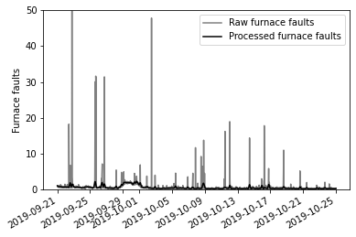
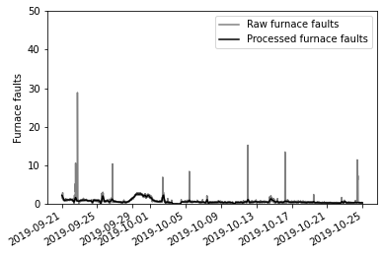
Dataset 1 (2019-09-21, around N=2400)
MK4 data ISRA 5D

Slide 3
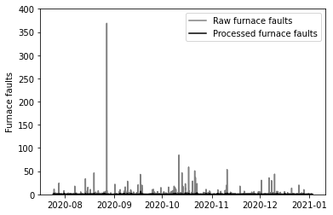
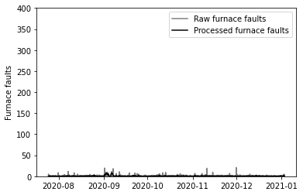
Dataset 2 (2020 to 2021, around N=11500)
MK4 data ISRA 5D

Slide 4
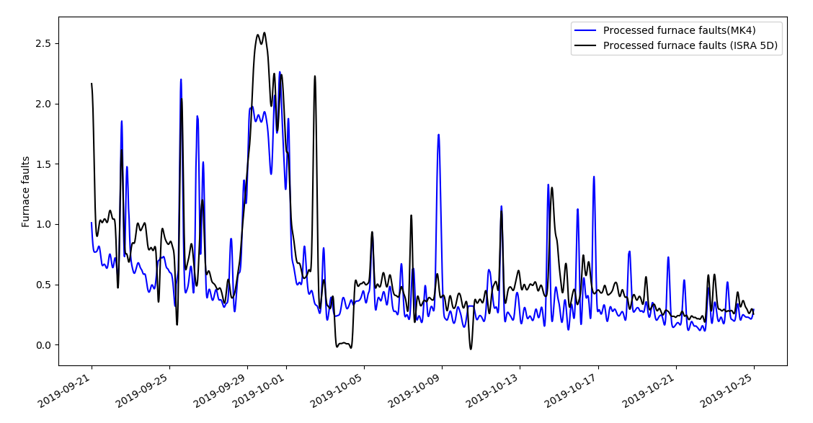
Dataset 1 (2019-09-21, around N=2400)
MK4 data compared with ISRA 5D

Slide 5
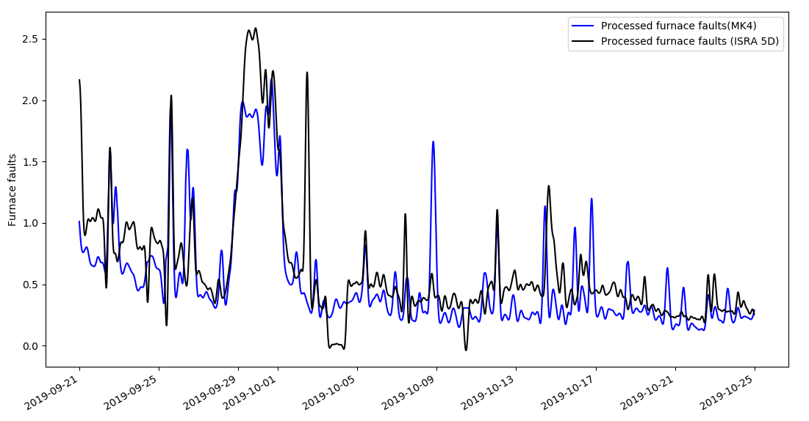
Dataset 1 (2019-09-21, around N=2400)
Changing filtering parameters (cutoff frequency = 0.08)

Slide 6
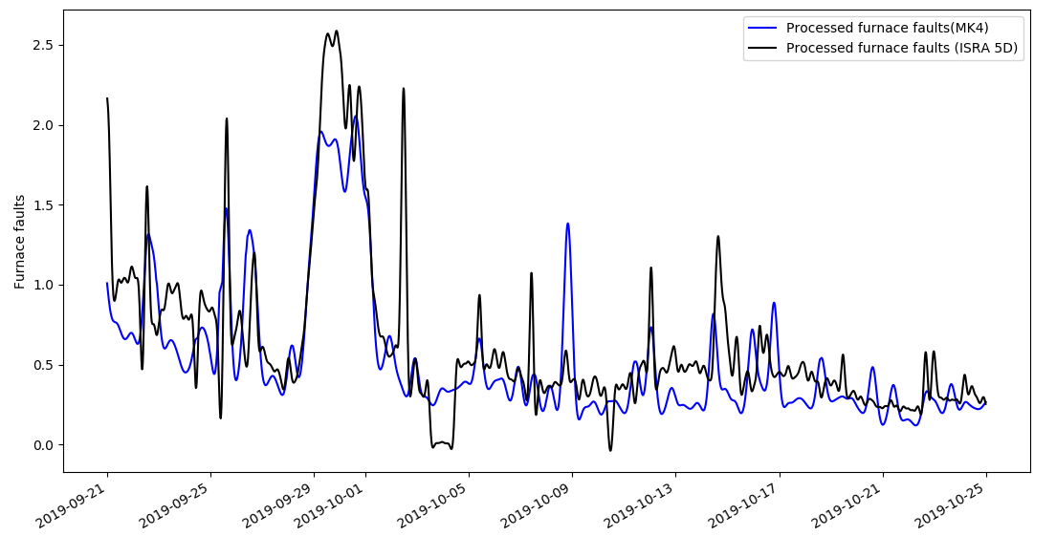
Dataset 1 (2019-09-21, around N=2400)
Changing filtering parameters (cutoff frequency = 0.05)

Slide 7
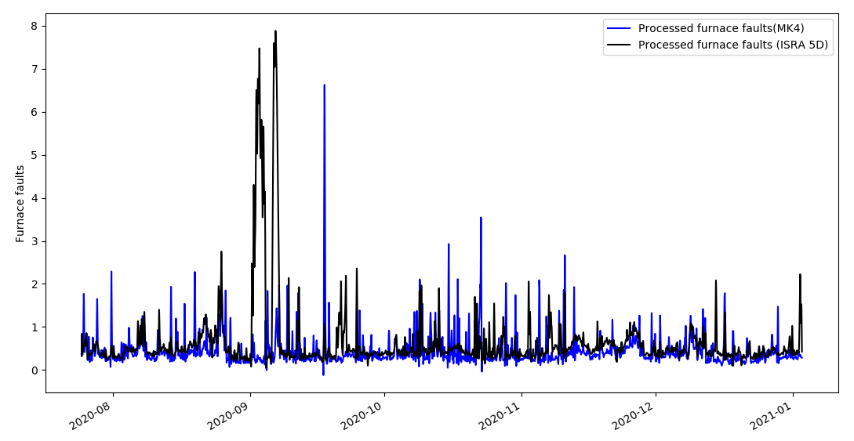
Dataset 2 (2020 to 2021, around N=11500)
MK4 data compared with ISRA 5D

Slide 8
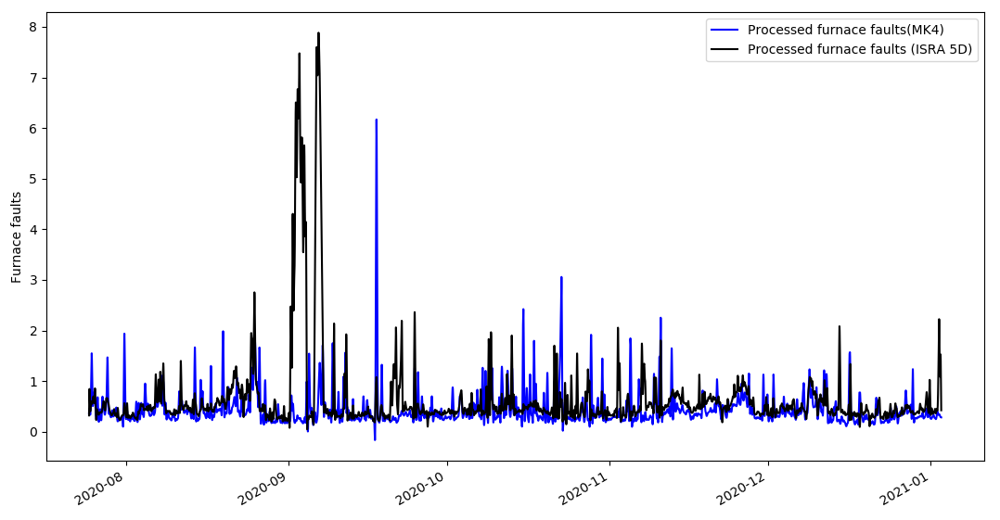
Dataset 2 (2020 to 2021, around N=11500)
Changing filtering parameters (cutoff frequency = 0.08)

Slide 9
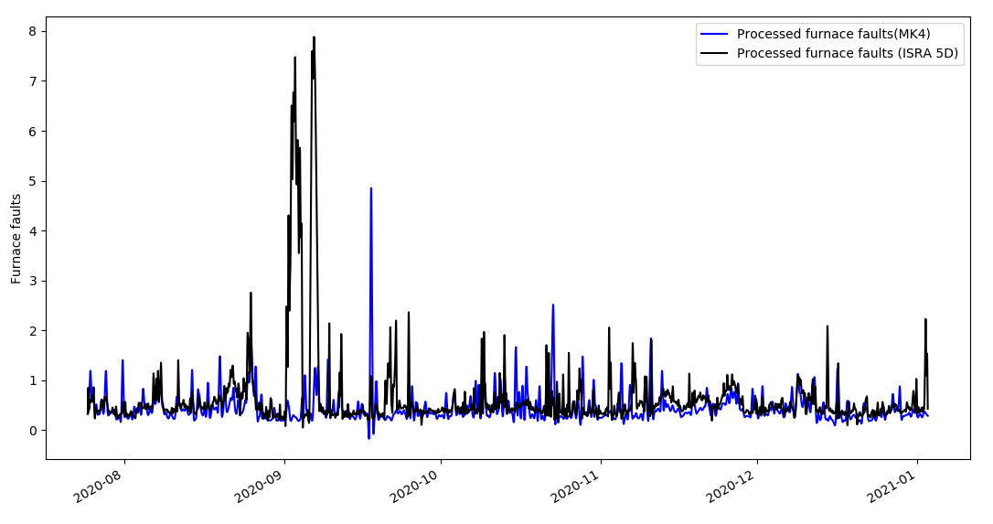
Dataset 2 (2020 to 2021, around N=11500)
Changing filtering parameters (cutoff frequency = 0.05)

Slide 10
Dataset 2 (2020 to 2021, around N=11500)
MK4 data compared with ISRA 5D

Slide 11
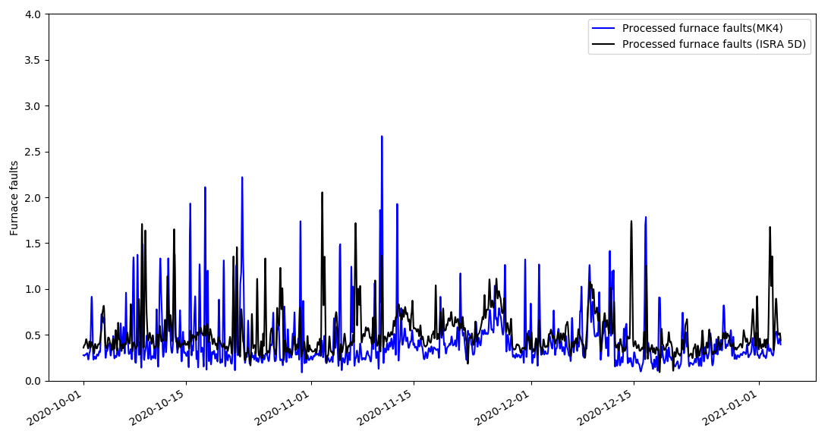
Dataset 2 (2020 to 2021, around N=11500)
MK4 data compared with ISRA 5D (Zoomed in for 2020-10-01 to 2020-11-01)

Slide 12
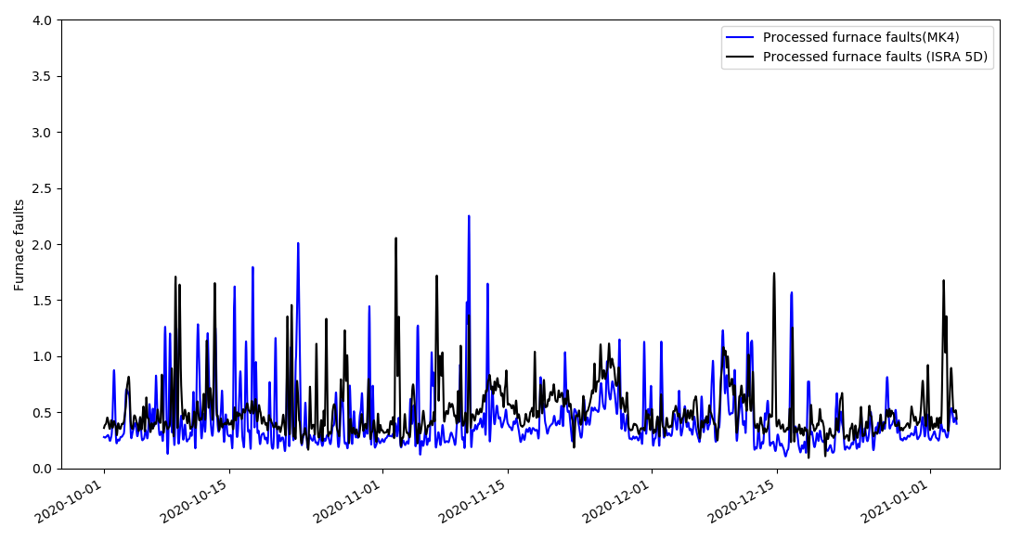
Dataset 2 (2020 to 2021, around N=11500)
Changing filtering parameters (cutoff frequency = 0.08)

Slide 13
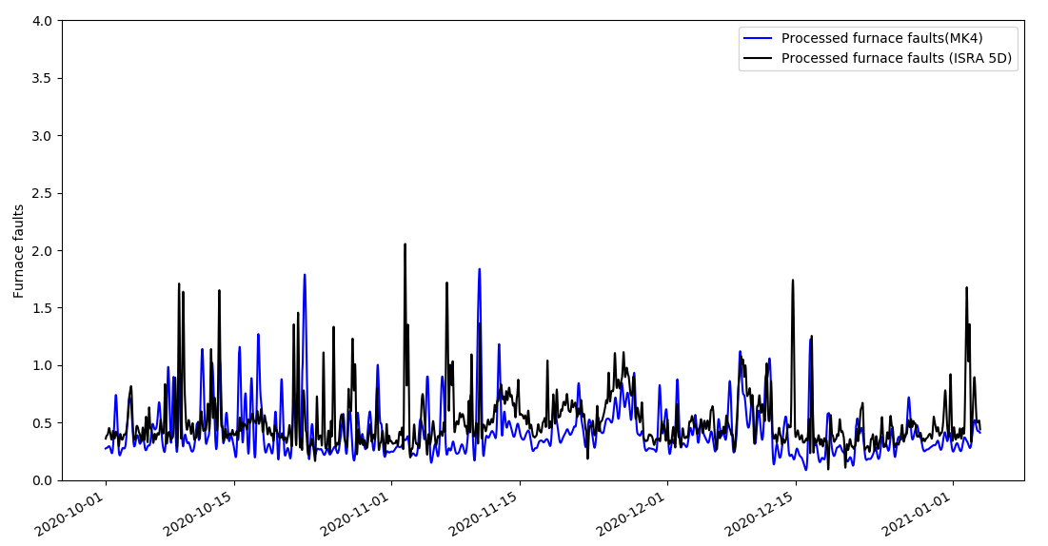
Dataset 2 (2020 to 2021, around N=11500)
Changing filtering parameters (cutoff frequency = 0.05)

Slide 14
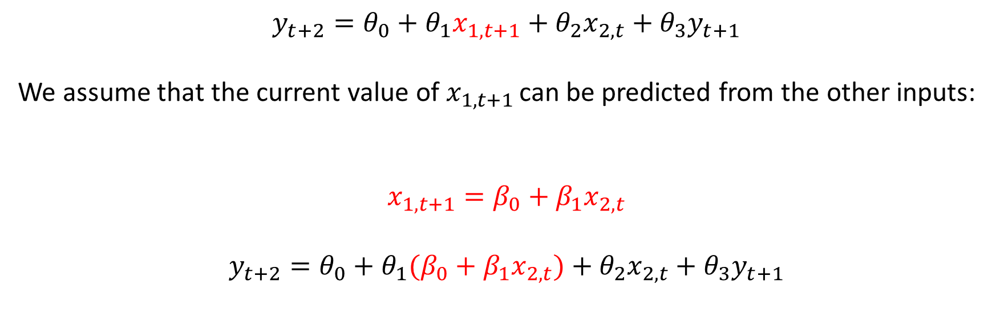
Why (not) the Recursive Model?
$$y_{t+2}=θ_{0}+θ_{1}x_{1,t+1}+θ_{2}x_{2,t}+θ_{3}y_{t+1}$$
We assume that the current value of $x_{1,t+1 }$can be predicted from the other inputs:
$$x_{1,t+1}=β_{0}+β_{1}x_{2,t}$$
$$y_{t+2}=θ_{0}+θ_{1}(β_{0}+β_{1}x_{2,t})+θ_{2}x_{2,t}+θ_{3}y_{t+1}$$

Slide 15
Why (not) the Recursive Model?
$$y_{t+2}=θ_{0}+θ_{1}x_{1,t+1}+θ_{2}x_{2,t}+θ_{3}y_{t+1}$$
We assume that the current value of $x_{1,t+1 }$can be predicted from the other inputs:
$$x_{1,t+1}=β_{0}+β_{1}x_{2,t}$$
$$y_{t+2}=θ_{0}+θ_{1}(β_{0}+β_{1}x_{2,t})+θ_{2}x_{2,t}+θ_{3}y_{t+1}$$
If this were true, one of the 2 inputs would have been removed because they are correlated!

Slide 16
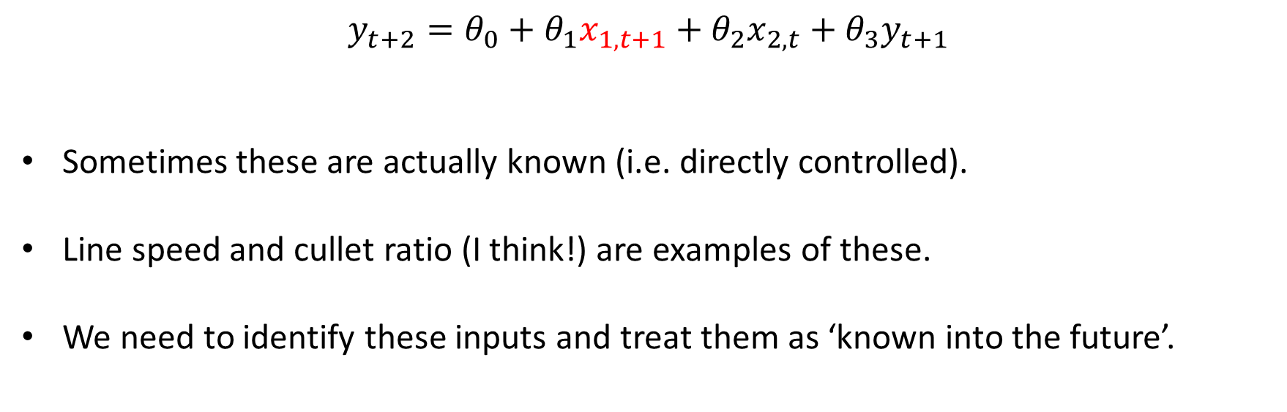
So how do we address future inputs?
$$y_{t+2}=θ_{0}+θ_{1}x_{1,t+1}+θ_{2}x_{2,t}+θ_{3}y_{t+1}$$
Sometimes these are actually known (i.e. directly controlled).
Line speed and cullet ratio (I think!) are examples of these.
We need to identify these inputs and treat them as ‘known into the future’.

Slide 17
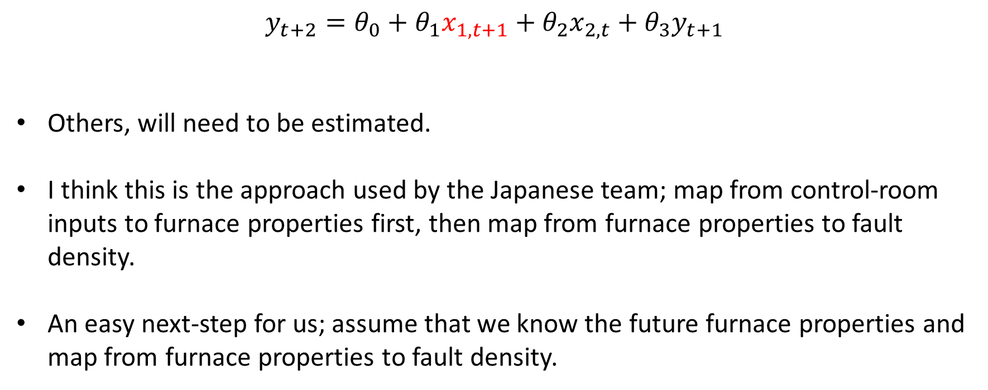
So how do we address future inputs?
$$y_{t+2}=θ_{0}+θ_{1}x_{1,t+1}+θ_{2}x_{2,t}+θ_{3}y_{t+1}$$
Others, will need to be estimated.
I think this is the approach used by the Japanese team; map from control-room inputs to furnace properties first, then map from furnace properties to fault density.
An easy next-step for us; assume that we know the future furnace properties and map from furnace properties to fault density.

Slide 18
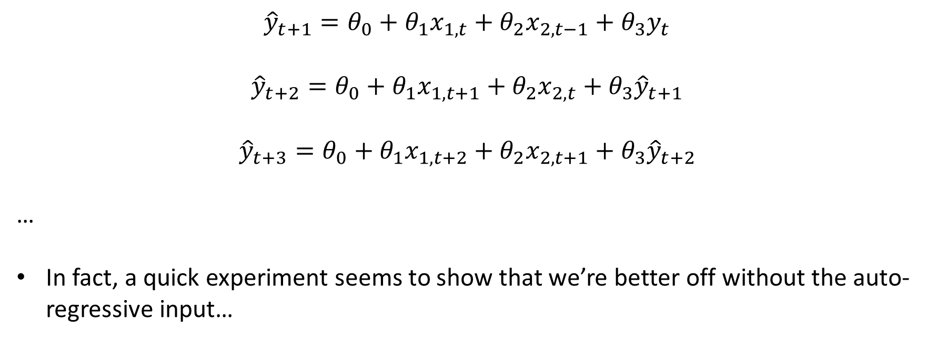
So how do we address future inputs?
$${\hat{y}}_{t+1}=θ_{0}+θ_{1}x_{1,t}+θ_{2}x_{2,t−1}+θ_{3}y_{t}$$
$${\hat{y}}_{t+2}=θ_{0}+θ_{1}x_{1,t+1}+θ_{2}x_{2,t}+θ_{3}{\hat{y}}_{t+1}$$
$${\hat{y}}_{t+3}=θ_{0}+θ_{1}x_{1,t+2}+θ_{2}x_{2,t+1}+θ_{3}{\hat{y}}_{t+2}$$
…
In fact, a quick experiment seems to show that we’re better off without the auto-regressive input…

Slide 19
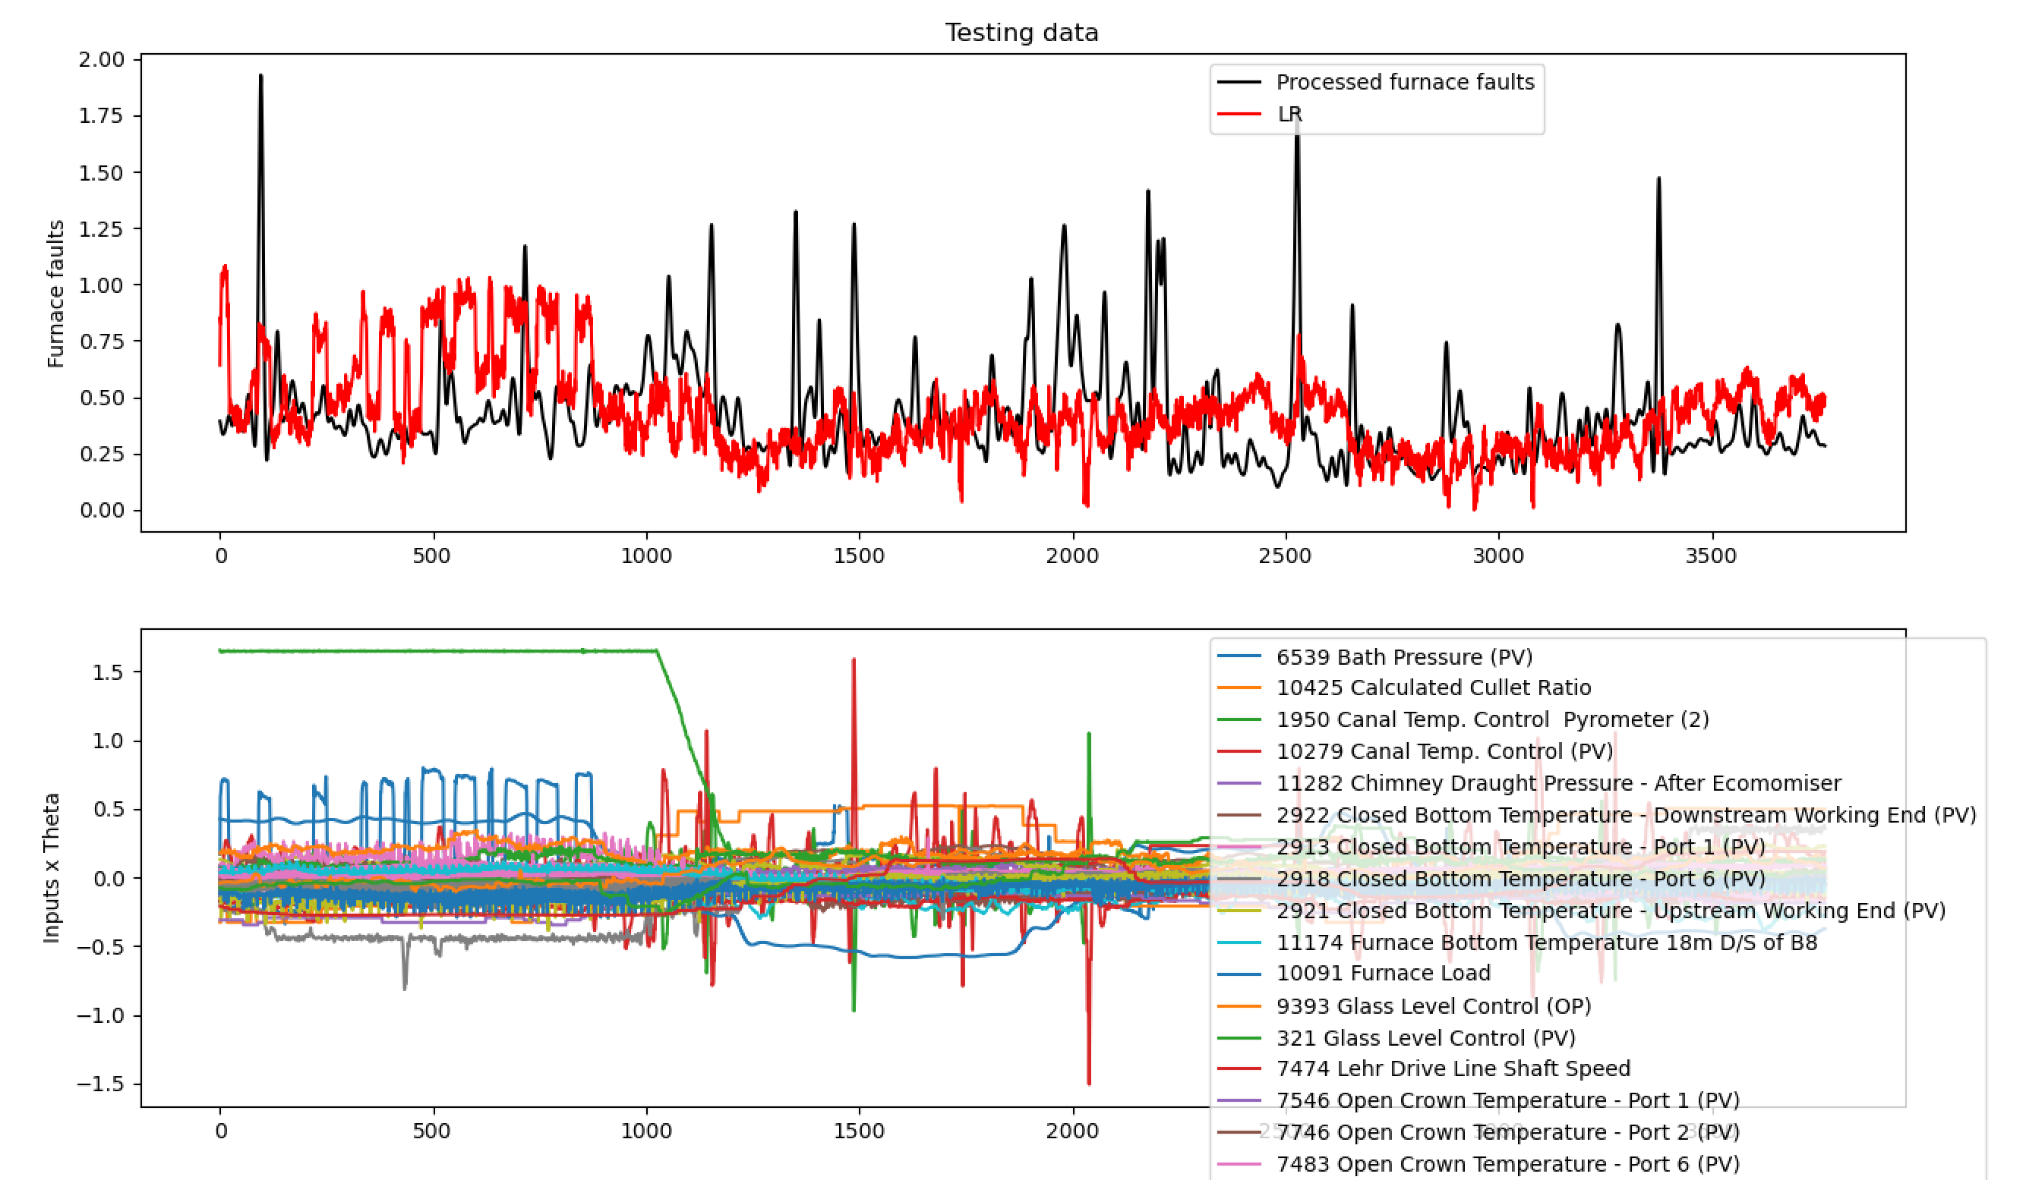
So how do we address future inputs?

Slide 20
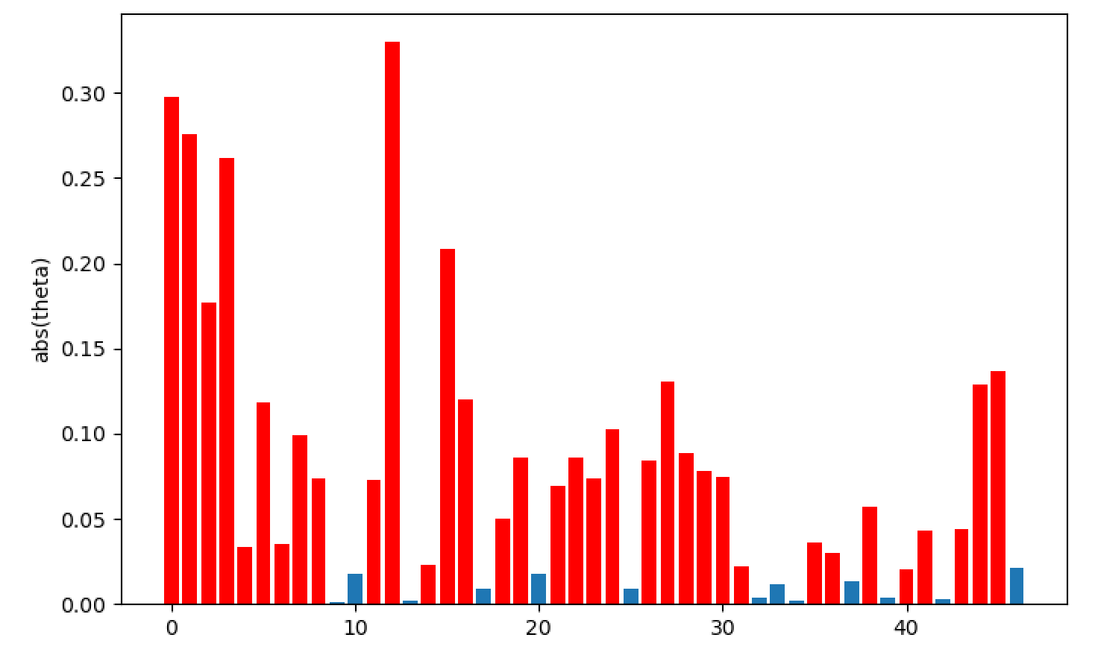
So how do we address future inputs?
Once we’re happy with this model, we then need to work out how we will estimate future furnace properties.

Slide 21
So how do we address future inputs?
We can try to estimate furnace properties from control inputs (similar to the Japanese approach).
Alternatively we can propose a separate model for how these furnace properties change over time.
Approach 2 might not be as bad as it sounds; frameworks for doing this (with uncertainty quantification already exits):
Linear: Kalman filter
Nonlinear: Extended Kalman filter / Particle filter

Slide 22
Future Work
Focus on improving this model (estimating the time lags randomly, tuning regularisation coefficient, removing non-relevant inputs, nonlinear model structures).
Then have a close look at the inputs that we believe are most relevant.
Establish whether or not they are directly controlled / need to be predicted.
Establish strategy for those that need to be predicted.

Slide 23
Thank you for your attention. ANY QUESTIONS?

